Slide 1
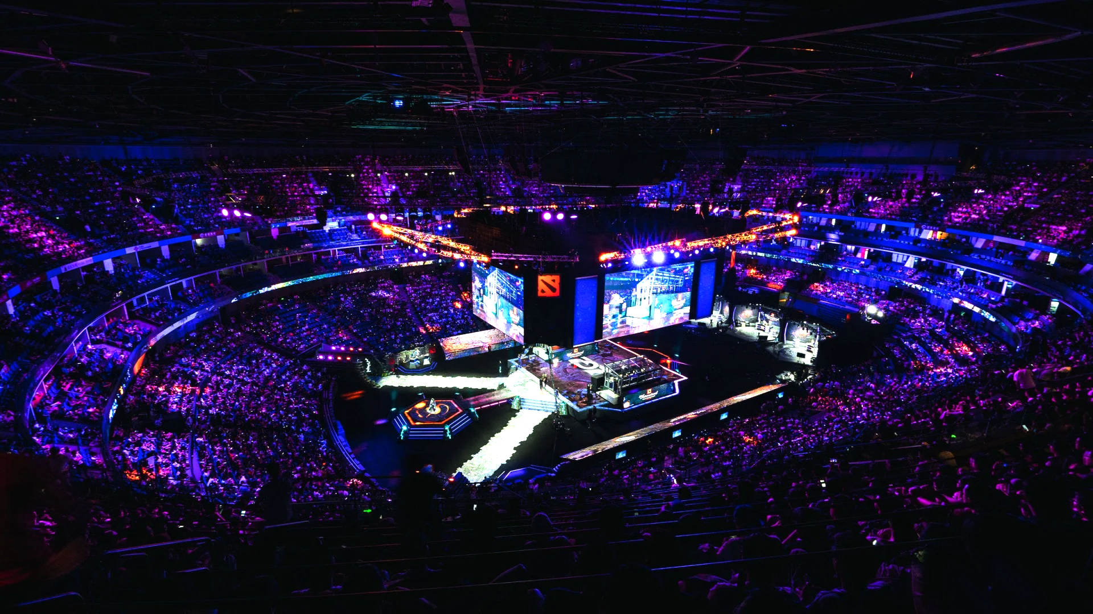
Predicting Wins in eSports
5/12/24
DATA698
Daniel Craig
Exploring how to predict the game behind $40 million tournaments in a $5.4bn industry
Notes:
This research was focused on predicting wins for one of the leading video games in the eSports Industry, Dota 2. Dota 2 claims the top 8 out of 10 spots for the highest prize pool tournaments in history with a strong fan base and top of class development teams in the MOBA genre. What is Dota 2 and what is a MOBA?

Slide 2
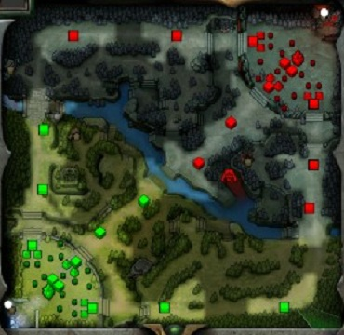



Dota 2 - A Summary
Two teams of 5 players, the ‘Radiant’ and ‘Dire’, pick heroes out of a pool of 124 for a total of 10 heroes
Teams split into three lanes and compete for gold by killing enemy units
As teams grow stronger, they aim to destroy the enemy’s base to win the game
The map of Dota 2 with the three lanes trailing the top side of the square, the bottom side, and the diagonal in the middle. The Radiant Team in the bottom left, and the Dire Team in the top right.

Slide 3
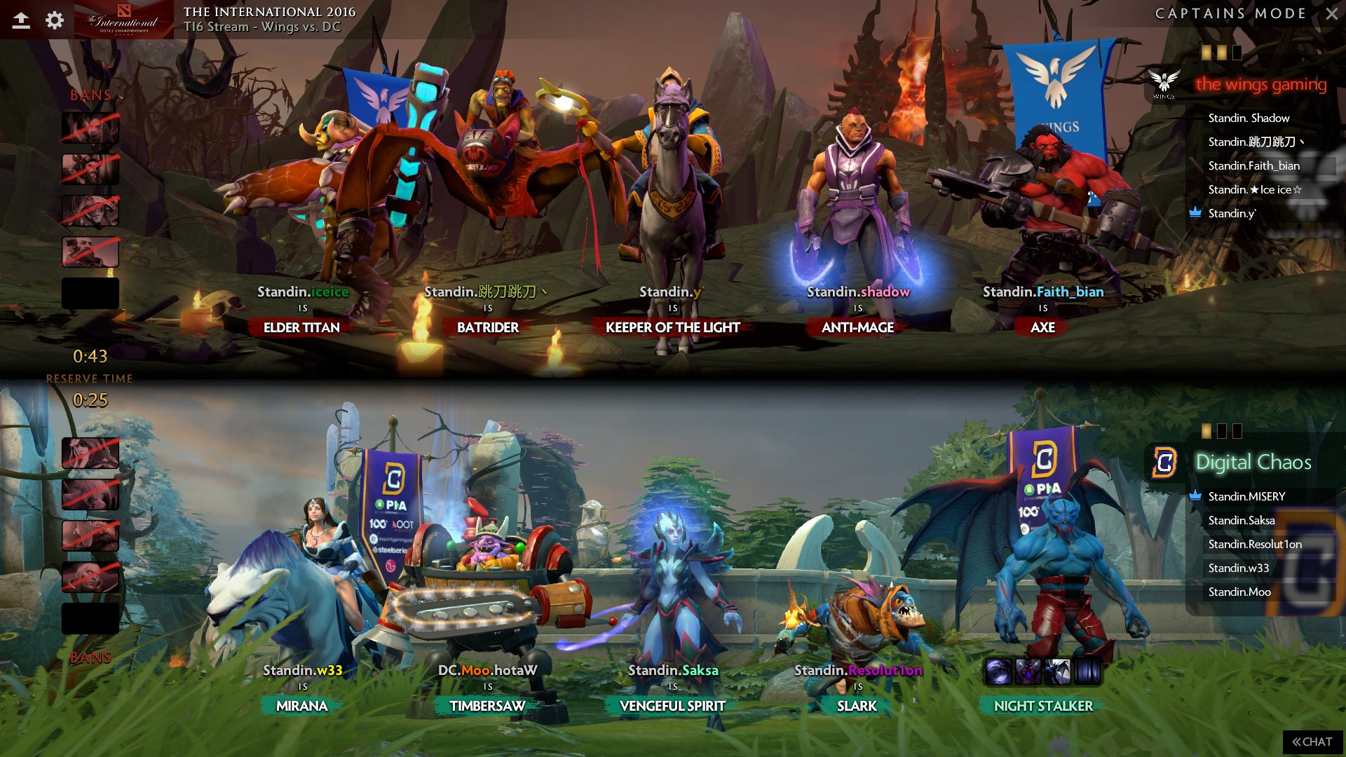

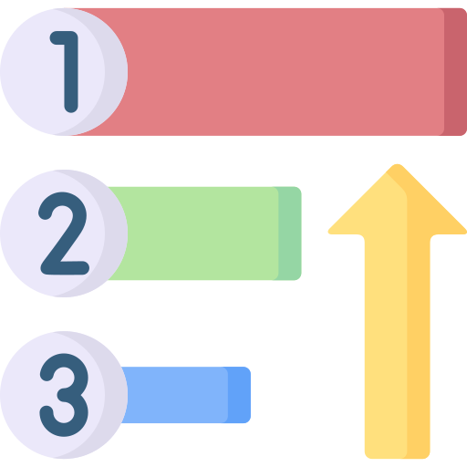

Dota 2 - Basic Team Composition
Gold is a limited resource, so who gets to gather it?
2
3
5
1
4
Teams are organized into positions of gold priority [1 - 5]
Spectator pick screen with positions of heroes and players labeled
Gold is considered the biggest determinant in who wins a game of Dota 2
Notes:
Since gold is a limited resource that players need to compete for, team composition has adapted to maximize gaining and using gold
Teams organize themselves into positions in order of gold gaining priority
Typically, position 1 heroes require the most gold, but also use it to impact the game more than other heroes.
Gold is considered the greatest determinant of who wins a game in Dota 2
With the basic fundamentals of the game established, what has prior research covered?

Slide 4
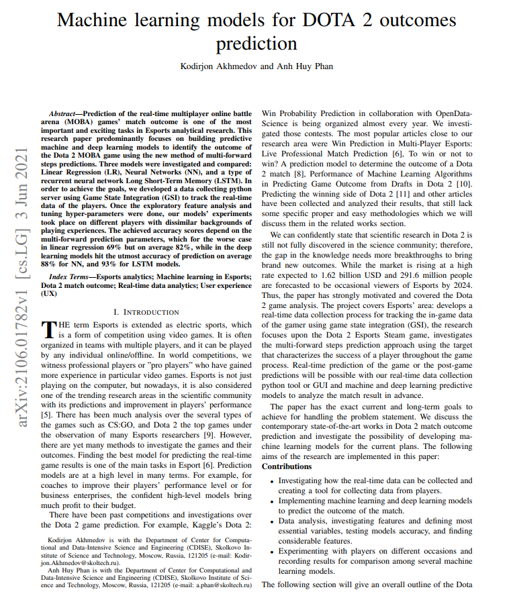
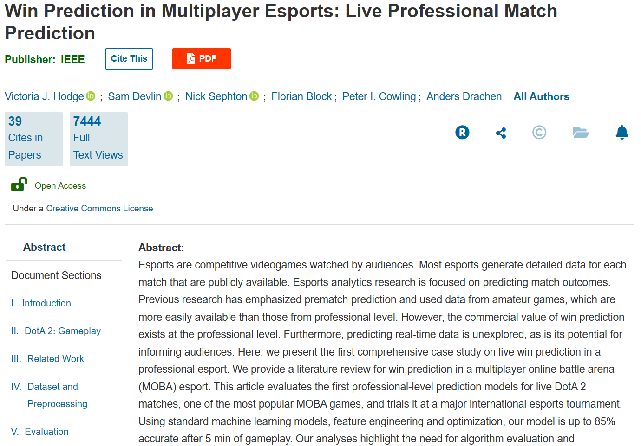
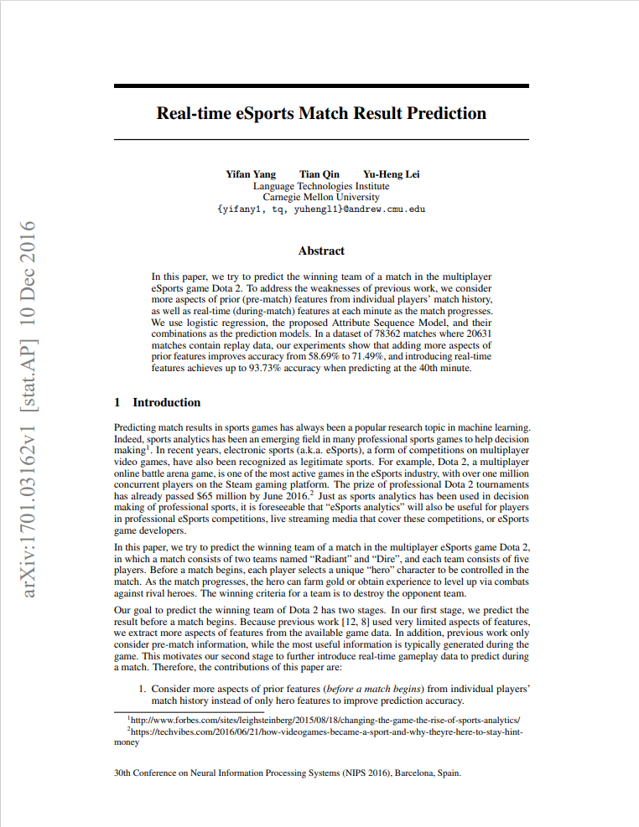
Past Research
LSTM
Log Reg/MS XGB
Attribute Sequence Model / Log Reg
Max_mana, gpm, last_hits, reliable_gold, etc.
Team Damage Dealt, Team Gold, Team Last Hits, Team Net Worth, Team XP, One-Hot Encoded Hero Feature
Pre-Game Player Metrics, One-Hot Encoded Hero Feature, Team Avg Net Worth / Deaths / Experience
70 - 75% Acc: 5 - 15 Mins
80 - 85% Acc: 20 - 30 Mins
85 - 90% Acc: 30 - 35 Mins
90 - 93% Acc: 35 - 40 Mins
91% Acc in predicted gold at 30 - 100 timesteps of .1 seconds
70 - 75% Acc in predicting a winner in pro-games
Notes:
All of these papers utilized a Game State Integration App to access live game data for data collection and analysis
First paper used 10 features to predict future amounts of gold using an LSTM - Ahkmedov and Phan
Second paper used 6 features requiring several hundred dimensions - Hodge, Devlin, et. al
Last paper used roughly 1500-2000 dimensional feature vectors - Yang, Qin, and Lei

Slide 5
Proposed Research
Past research:
- ignored positional gold values in lieu of team averages
- captured hero features as one-hot encoded vectors
- ignored future anticipated gold values as features
- used Game State Integration Apps for a wealth of data
Proposed research:
- utilize positional gold values over team average values
- capture heroes as features using a trained LSTM embed layer
- observe the impact of using forecasted gold values as a feature
- used OpenDota API for a more restricted dataset
Why:
- Positions have differing levels of influence on the game based on their gold
- an trained, in-depth hero feature may be more impactful than a simple one-hot encoded value
- an expectation of future gold represents anticipated hero impact
- Lack of resources

Slide 6


Research Questions
LSTM Features
Goal: Predict with comparative accuracy using less data
LSTM used prior gold amounts, and a hero vector as features
An improvement could be adding other features such as last hits or experience
How does representing heroes as a trained embedded vector impact accuracy?
How do expected future values of gold impact accuracy?
How do positional values of gold rather than team averages impact accuracy?
X - Gold Values
T-5 | .0012 | -0.5 | 1.3
T-4 | .0036 | -0.5 | 1.3
T-3 | .0050 | -0.5 | 1.3
T-2 | .0062 | -0.5 | 1.3
T-1 | .0083 | -0.5 | 1.3
T | y
X - Hero Embedding Vector
Predicted Gold Value
Notes:
The goal of this paper was to achieve comparative accuracy with less data using a few different methods.
The first method was to have a better representation of heroes in the trained embedded vector from the LSTM. The hope is that the unique relationships between a hero and gold are captured more effectively by using something more than a one-hot encoded matrix.
The second method was to validate whether anticipated values of gold could be used as a feature that would improve accuracy
The third method was to use the distribution of gold amongst a team, that is which position has how much gold, rather than overall team metrics

Slide 7
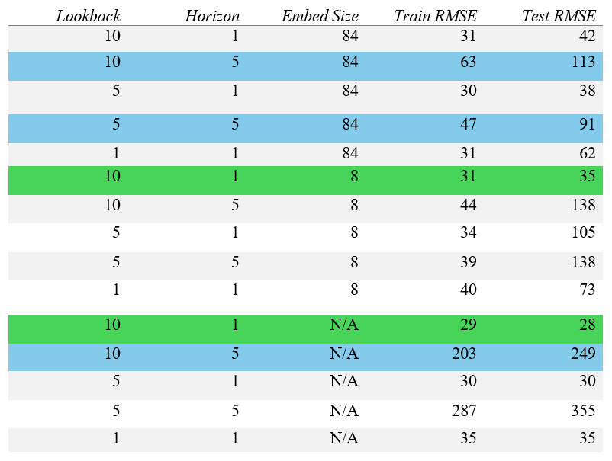
LSTM | Do embeddings increase accuracy?
Lookback: Number of previous values of gold were allowed as input
Horizon: Number of values forecasted out
Embed Size: How many elements were allowed to represent a hero
Shorter Horizons performed better with less or no embed sizes
Longer Horizons performed better with larger embed sizes
* A medium impact item in Dota 2 costs about 4000 gold and purchased around the 25 minute mark
* RMSE is averaged across the entire Horizon and represents error for a single minute
Notes:
There were 3 dimensions to the LSTM model - Lookback, Horizon, Embed Size
Lookback had 3 different levels; 10, 5, and 1
Horizon had 2 different levels; 1 and 5
Embed Size had 3 different levels; 84, 8, and none
The results from the LSTM showed that shorter horizons performed better without embeddings, but Longer Horizons performed better with them
RMSE values shown here are scaled back to their regular size and represent the amount of gold, averaged over an entire match, a single prediction was incorrect by

Slide 8
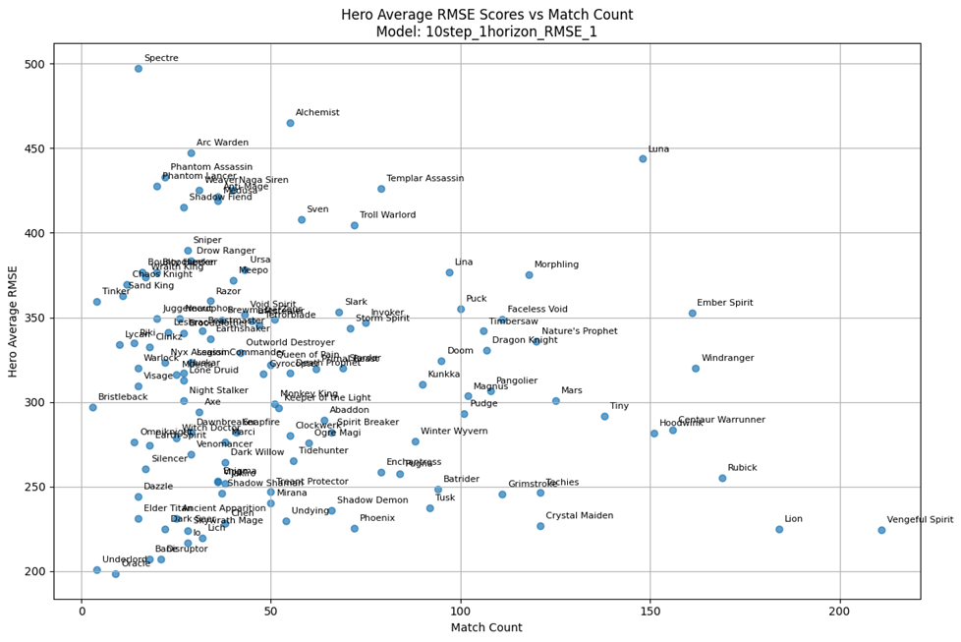
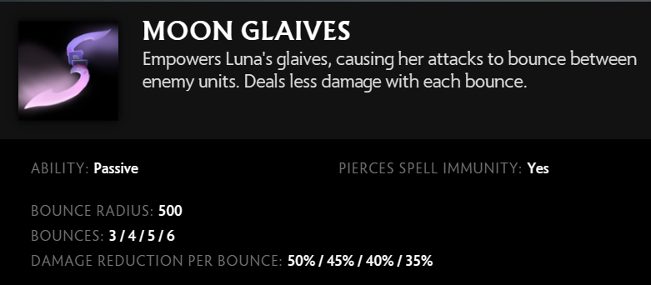
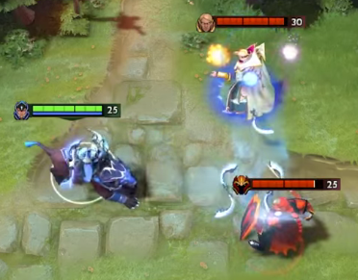

LSTM Performance per Hero/Match
Model: 10 Lookback | 1 Horizon | No Embed
High RMSE Scores associated with High Farming Rate heroes (“Feast or Famine”)
Notes:
The best performing model was the 10 lookback, 1 horizon, No Embedded model.
The Test RMSE looked quite good, this scatter plot helps characterize high and low performing heroes.

Slide 9
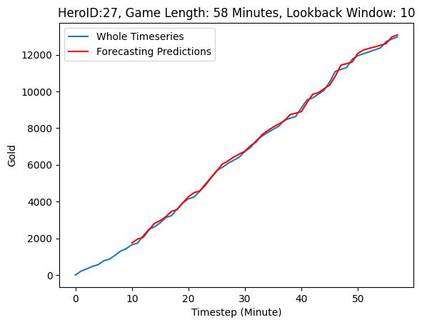
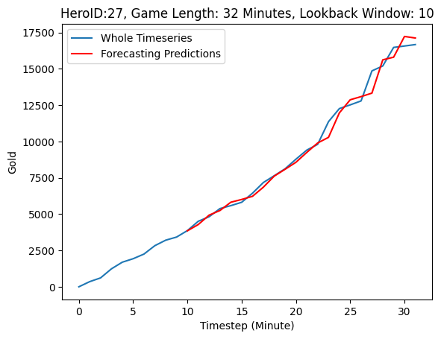
Examples of LSTM (10LB | 1 Horizon | No Embed Model)
Lowest Error RMSE Test Error Time-Series
Highest RMSE Test Error Time-Series
Notes:
Here are examples of the LSTM’s effectiveness over an entire match. The left plot being one of the best, and the right plot being one of the worst. Both are fairly strong, despite the lack of using 10 features in a multi-variate time series prediction from the first study.
How did the Embedded LSTM model fair?

Slide 10
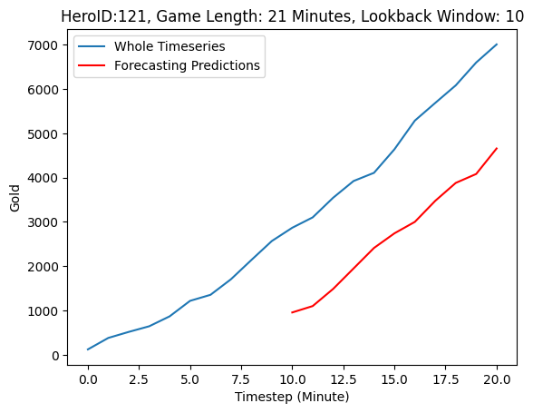
Examples of LSTM (10LB | 1 Horizon | 8 Embed Model)
Lowest Error RMSE Test Error Time-Series
Highest RMSE Test Error Time-Series
Notes:
The best embedded model seemed promising, but its errors suggested some type of instability and were not used. Overall hero average RMSE scores were in the thousands compared to the non-embedded models scores of less than 500.
Due to this, the non-embedded model was used for forecasting gold values to check for their impact.

Slide 11
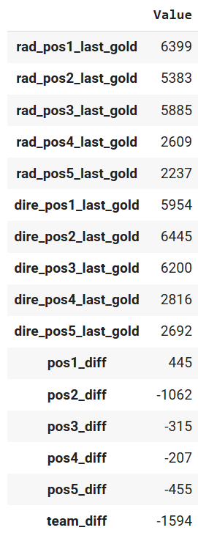

RandomForest & XGBoost Base Features
Features:
Due to computing limitations, models were trained individually at every 5 minutes between 15 - 40 minutes
‘Last_gold’ represents the amount of gold the hero is currently worth at the current point in time
‘pos_diff’ represents the difference in gold between positions, negative values mean an advantage towards the ‘dire’ team
Notes:
Due to computational limits, a model and dataset was trained for every 5 minutes starting from minute 15 to 40. While this method was done to accommodate a practicality issue, this also has the advantage of showing feature importance differences at every minute mark cleanly.
The gold value of each position for each team at that minute mark, as well as positional differences and an overall team difference were given as features to the classifier models. Embeddings of each hero, which were tested with the 8 embed size, resulting in 8 x 10 = 80 new columns for each row, actual gold values, and predicted gold values were rotated in and out to see their effects on the classifier’s accuracy

Slide 12
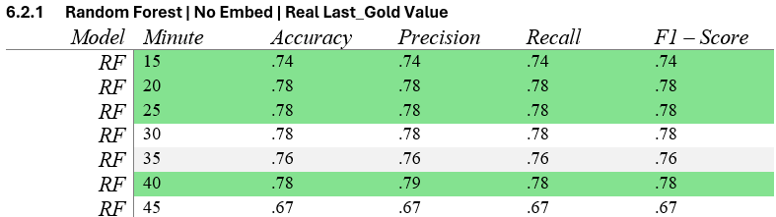
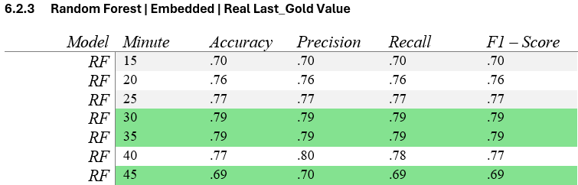
RF | Do embeddings improve accuracy?
Embeddings seem to make little difference if losing some accuracy at times
Notes:
When comparing the Random Forest classifier with real last gold values, and an embedding, it seemed that most steps lost accuracy.

Slide 13
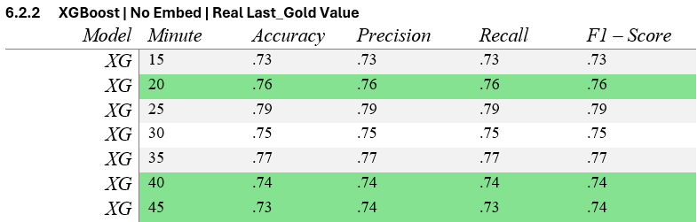
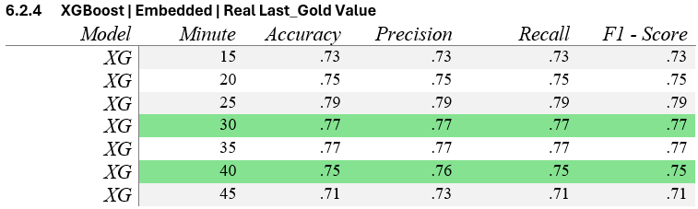
XG | Do embeddings improve accuracy?
Embeddings seem to make little difference if losing some accuracy at times
Embeddings do not make a significant impact in either the XG or RF models ability to predict a game’s outcome
Notes:
Comparing the XGBoost model finds a similar marginal effect.
Accuracy = in general, how many predictions did I get right out of all the possible predictions
Precision = how well the model can identify positive values, including the false positives. This places importance on making a false positive prediction, i.e. diagnosing someone with cancer
Recall = how well the model identifies positive values, including the false negatives. This places importance on missing a prediction, i.e. failing to detect a fraudulent painting is costly
F1 = Is a ratio between Precision/Accuracy and balances the two

Slide 14
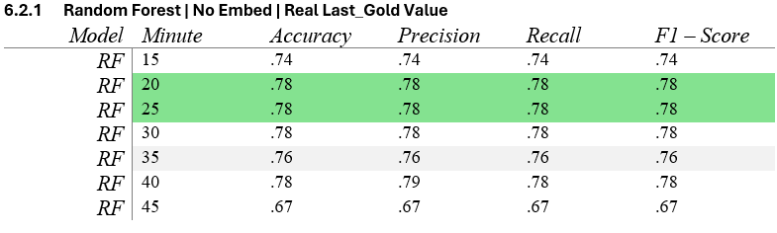
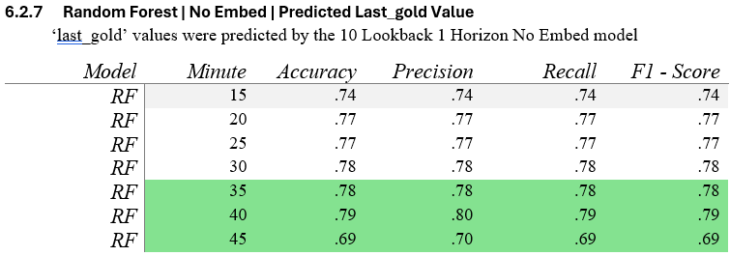
RF | Do forecasted values impact accuracy?
Predicted values seem to increase accuracy at later stages in the game, but drop accuracy at earlier stages
Notes:
In this comparison, we’re replacing the actual gold value with a value predicted by the LSTM using the previous 10 gold steps. The effect is slight, but it seems that predicted values might be increasing accuracy at later stages in the game.

Slide 15
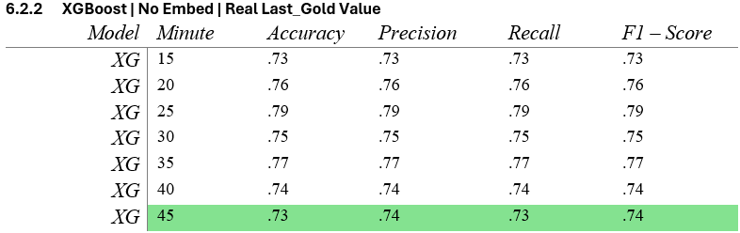
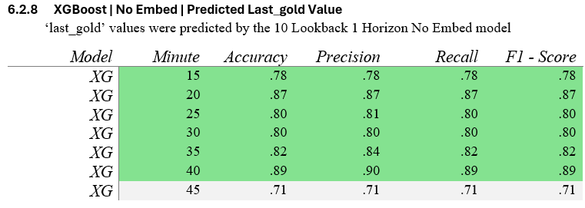
XG | Do forecasted values impact accuracy?
The XG model seems to respond with higher accuracy across most minute marks with predicted values
Forecasted values seem to have at least some positive impact on accuracy
Notes:
For the XGBoost model, this seems to have had a profound effect across almost all time steps. This may suggest that the anticipated amount of gold a hero would have, is actually an important feature in determining a winner, that isn’t latently apparent to the model in current gold values.

Slide 16
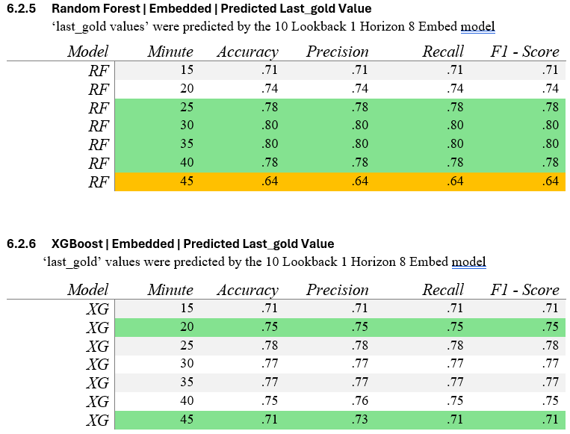
RF & XG | Do embeds + predictions impact accuracy?
The combination does not seem to impact accuracy greatly outside of the 45 min. mark which was a negative effect
Notes:
The combination does not seem to have a large impact on accuracy, and significantly drops accuracy at the 45 minute mark.
There were only a few hundred games that passed the 45 minute mark, and poor accuracy at this stage may be indicative of a lack of training data

Slide 17
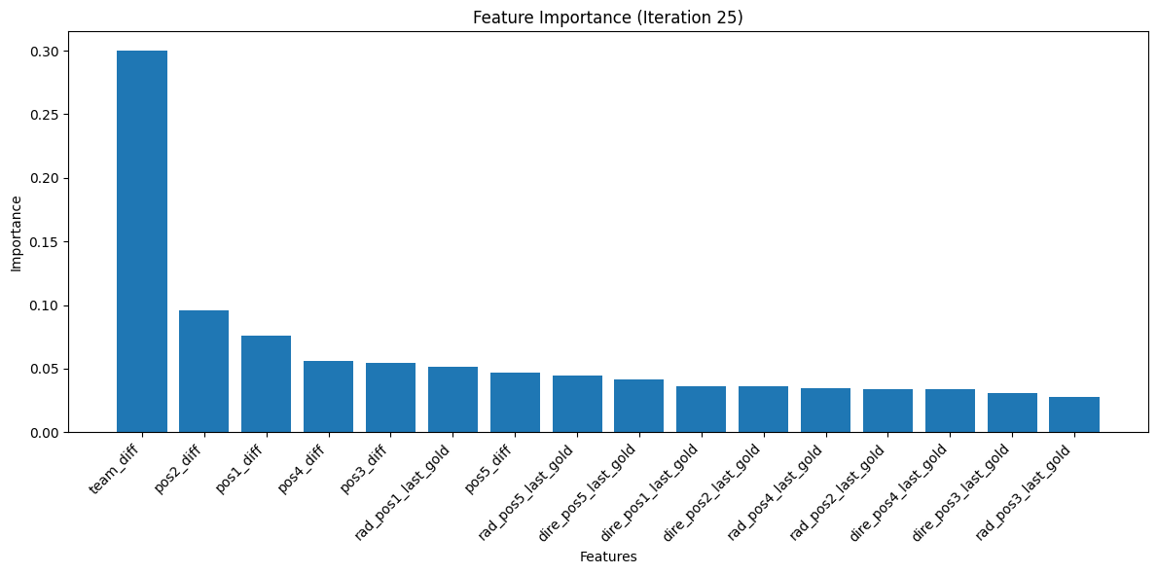
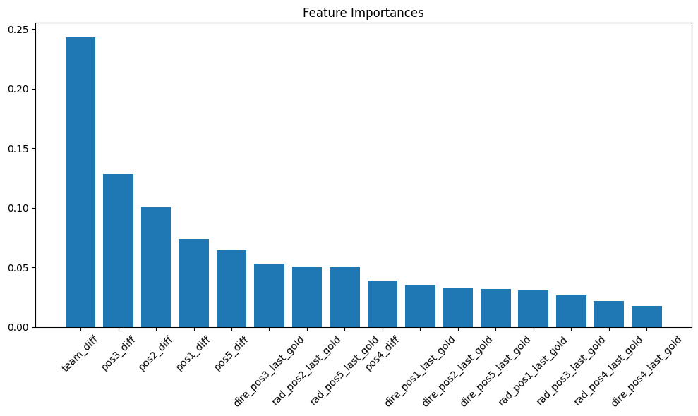
Examples of XG/RF Feature Importance
XG | 25 Minutes
RF | 30 Minutes

Slide 18
Research Questions
Answers
How does representing heroes as a trained embedded vector impact accuracy?
How do forecasted values of gold impact accuracy?
How do positional values of gold rather than team averages impact accuracy?
Accuracy both increased and decreased at marginal levels. Overall, no meaningful useful
Forecasted values tended to have no impact or increase values
In comparison to past research, positional values of gold seems to achieve higher accuracy
Notes:
If we trail back to some of the questions we hoped to answer, we can match up our answers.

Slide 19


New Questions
Improvements
How would forecasts of greater horizons impact classifiers?
How would using multiple forecasted values of gold impact classifiers?
Would predicting when a game would end be a useful feature for classifiers?
Would one-hot encoding increase performance over no-embed and embedded models?
Comparisons of horizon lengths on classifier accuracy using 1, 5, or more steps may prove helpful
Inclusion of more features:
- damage dealt by player
- experience
- last hits
With more computational power, a single model utilizing the minute as a feature would remove the need of training a model at each minute as done in this research

Slide 20
Data Sources/Code Appendix:
Berntsen, B. (2021, July 5). Dota 101: A beginner’s guide to drafting - dota 2. esports.com. https://www.esports.com/en/dota-101-a-beginners-guide-to-drafting-246519
Esports - worldwide: Statista market forecast. Statista. (n.d.). https://www.statista.com/outlook/amo/esports/worldwide
Lozano, K. (2022, October 10). How the prize pools for dota 2’s the international became the biggest in esports. ONE Esports. https://www.oneesports.gg/dota2/dota-2-prize-pool-international-esports/
Akhmedov, K. and Phan, A. H., “Machine learning models for DOTA 2 outcomes prediction”, <i>arXiv e-prints</i>, 2021. doi:10.48550/arXiv.2106.01782.
Yang, Y., Qin, T., and Lei, Y.-H., “Real-time eSports Match Result Prediction”, <i>arXiv e-prints</i>, 2016. doi:10.48550/arXiv.1701.03162.
V. J. Hodge, S. Devlin, N. Sephton, F. Block, P. I. Cowling and A. Drachen, "Win Prediction in Multiplayer Esports: Live Professional Match Prediction," in IEEE Transactions on Games, vol. 13, no. 4, pp. 368-379, Dec. 2021, doi: 10.1109/TG.2019.2948469.

Slide 21
Data Sources/Code Appendix:
Icons/Images:
https://teamsecret.gg/cdn/shop/articles/blog_ti9_1920x.jpg?v=1596668697
https://www.flaticon.com/free-icons/warrior" title="warrior icons" Warrior icons created by PIXARTIST - Flaticon
https://www.flaticon.com/free-icons/warrior" title="warrior icons">Warrior icons created by Freepik - Flaticon
"https://www.flaticon.com/free-icons/earthquake" title="earthquake icons">Earthquake icons created by Konkapp - Flaticon
https://www.flaticon.com/free-icons/gold" title="gold icons">Gold icons created by wanicon - Flaticon
https://www.flaticon.com/free-icons/position" title="position icons">Position icons created by Freepik
https://www.flaticon.com/free-icons/finance" title="finance icons">Finance icons created by Smashicons - Flaticon
https://www.flaticon.com/free-icons/code" title="code icons">Code icons created by Freepik - Flaticon
https://www.flaticon.com/free-icons/question-mark" title="question mark icons">Question mark icons created by Freepik - Flaticon

Slide 22
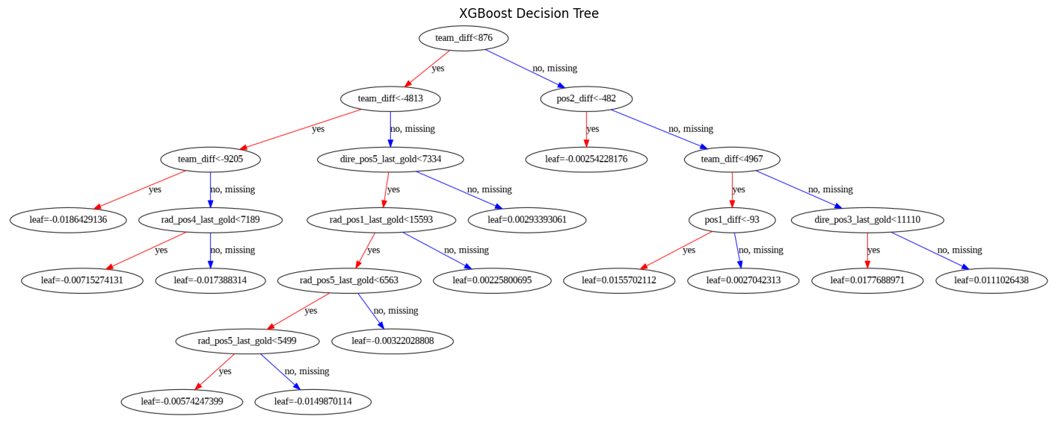
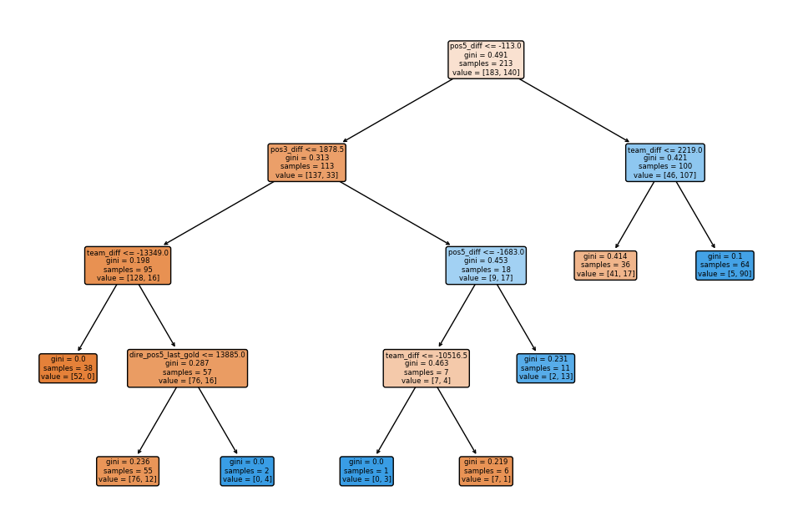
Examples of XG/RF Trees
XG | 25 Minutes
RF | 30 Minutes
Notes:
Observing some of the most accurate decision trees generated for each type of model reveals repeating patterns of the overall team difference in gold being highly important. This also shows how different positional values at different times become important at different points in the game.

